Slide 1
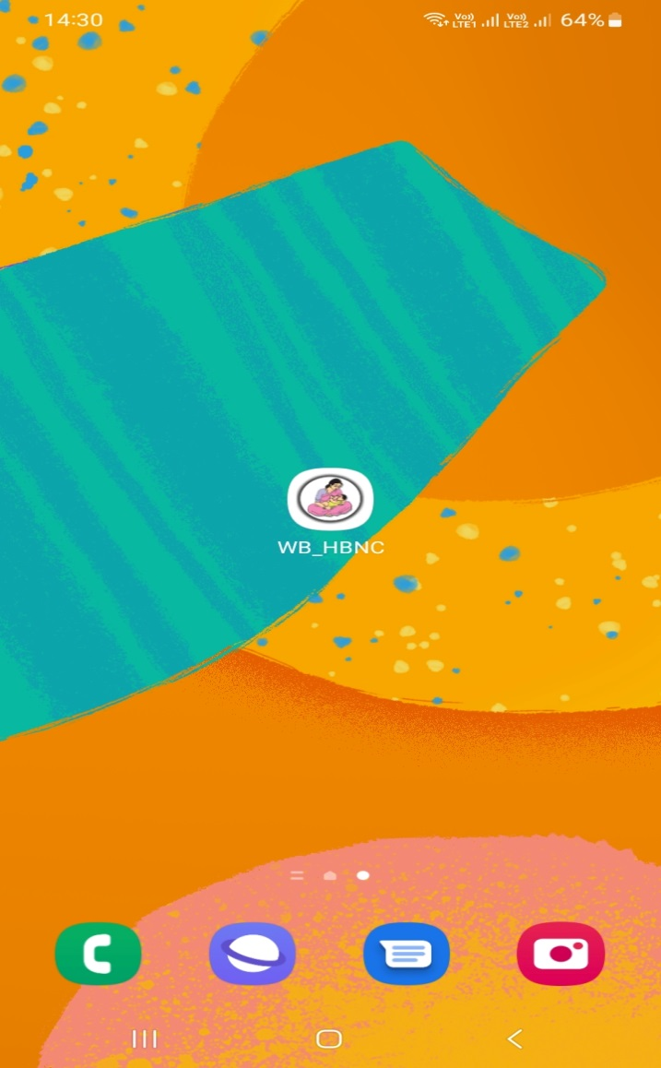
How to use the application?
Tap on
HBNC Icon

Slide 2
This splash screen will appear

Slide 3
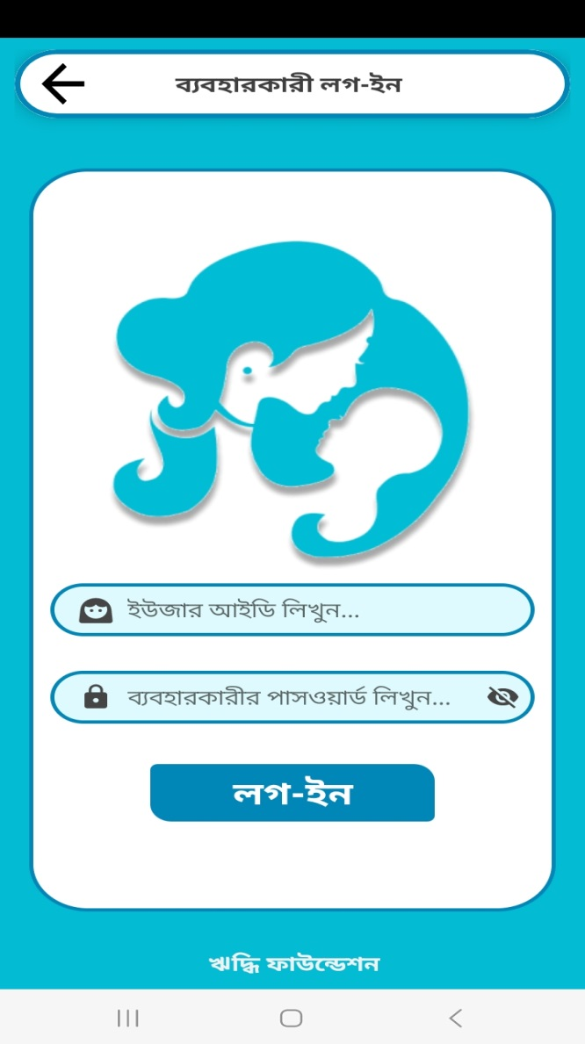
User login
Note- Mobile internet connectivity is required
Enter your user ID and password and tap on login

Slide 4
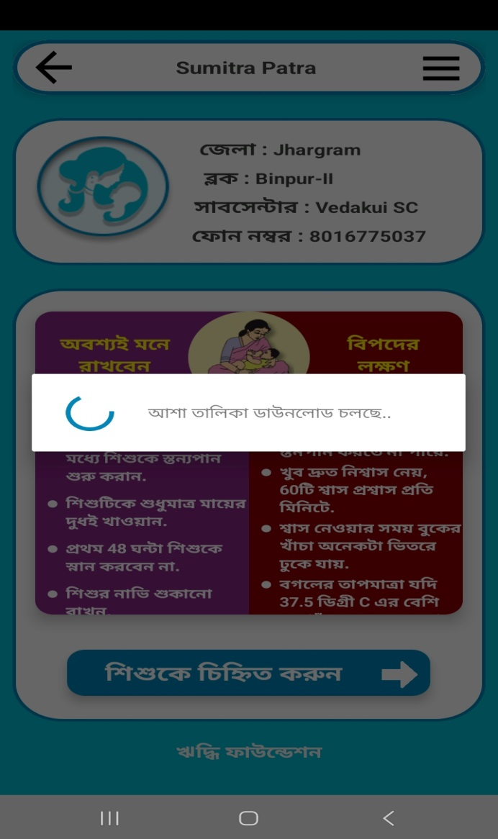
Note- Mobile internet connectivity is required
Please wait for few seconds, the application will download user and ASHA details

Slide 5
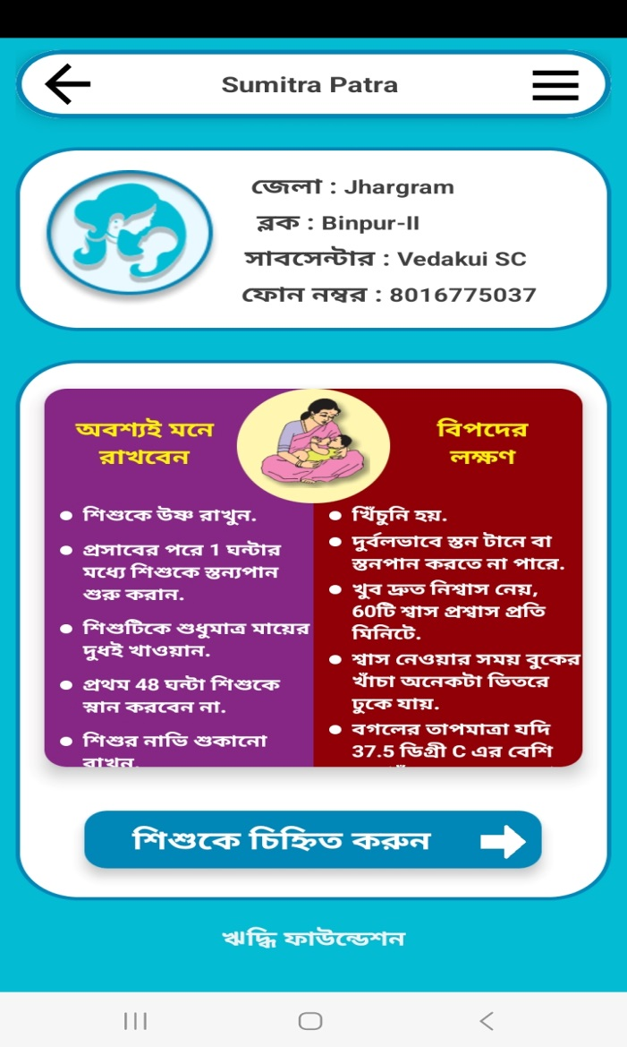
Login Completed
Based on login credential (user ID), the application will auto-populate the Sub-Centre and ANM details

Slide 6
Care of Newborn

Slide 7
Tap Here

Slide 8
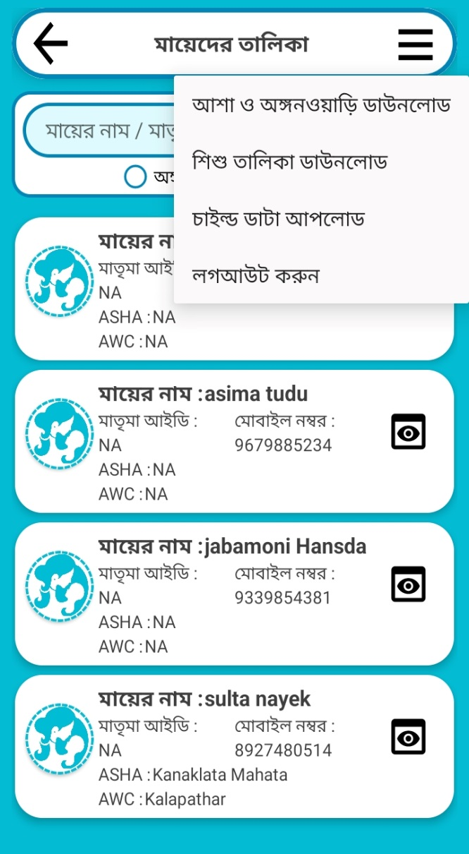
Tap on Child Data Download

Slide 9
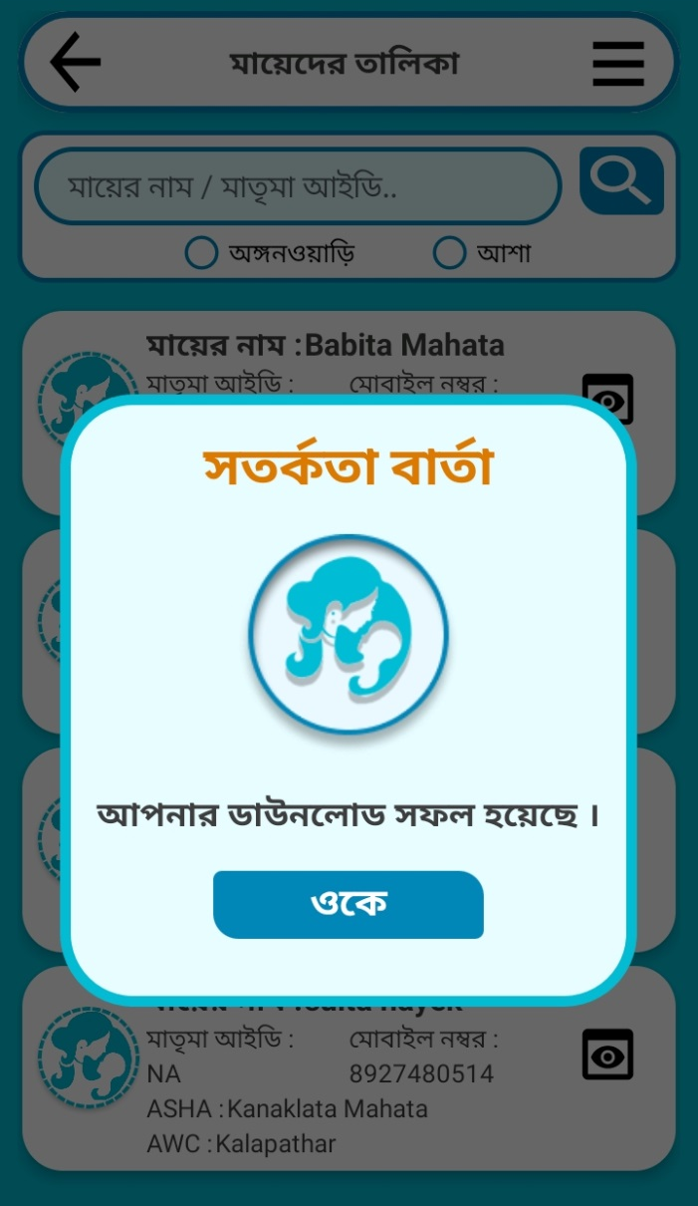
Tap on ‘ok’ Data Download Complete

Slide 10
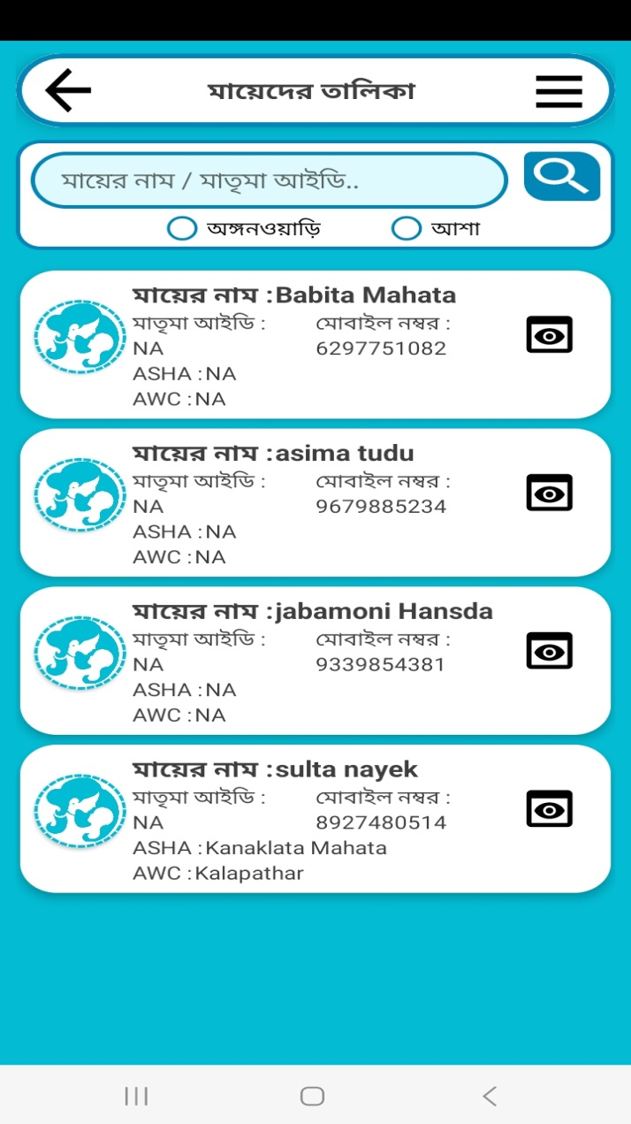
List of Mother

Slide 11
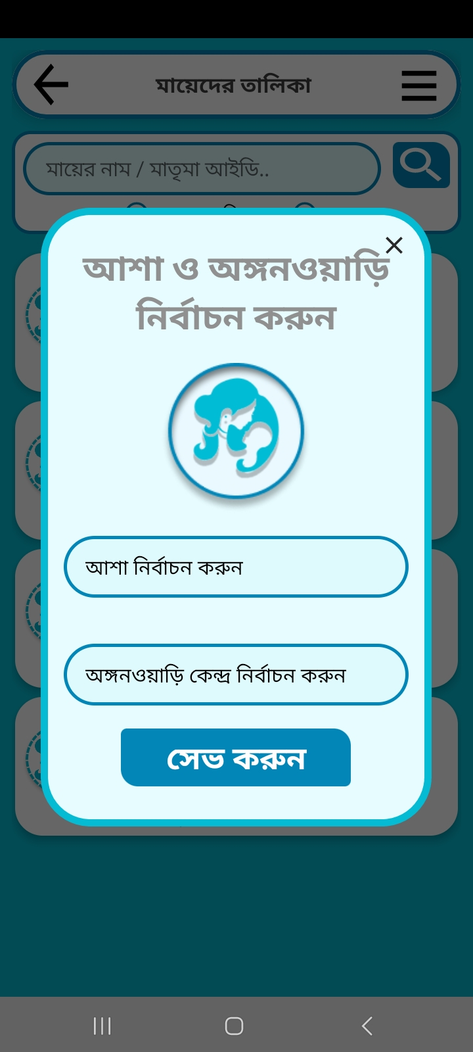
ASHA and AWC Tag

Slide 12
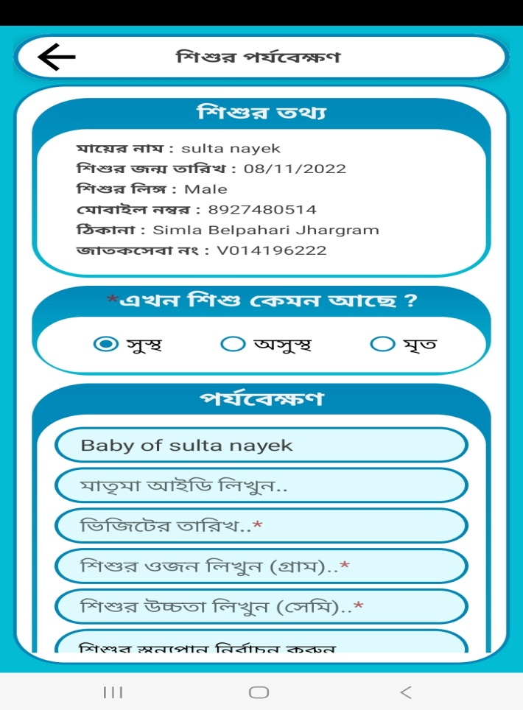
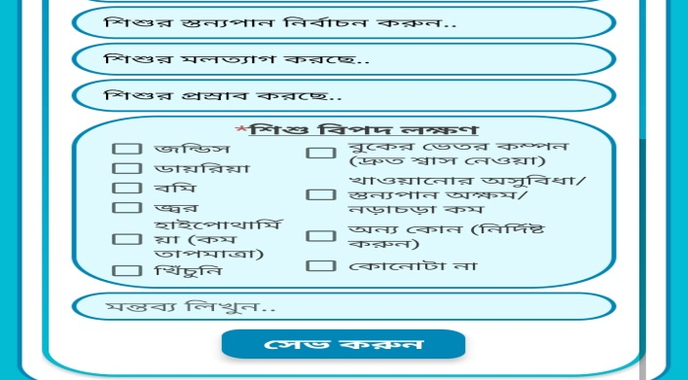
Child Monthly Monitoring
Tap on ‘save and upload’ button

Slide 13
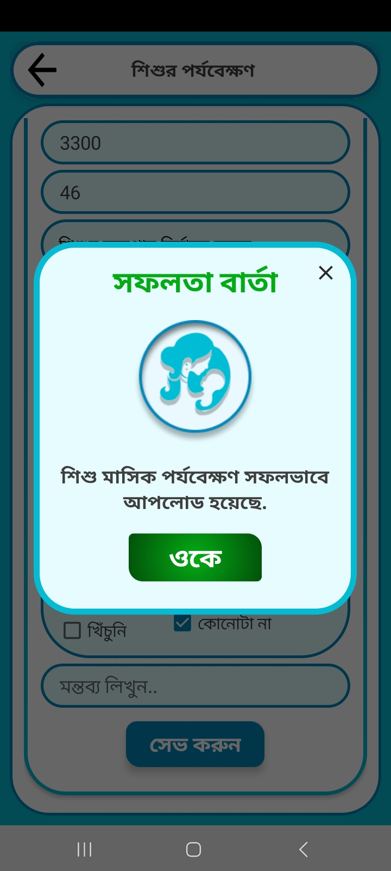
Tap on ‘ok’ data upload Completed

Slide 14
Note- Mobile internet connectivity is required
Tap on Upload stored files

Slide 15
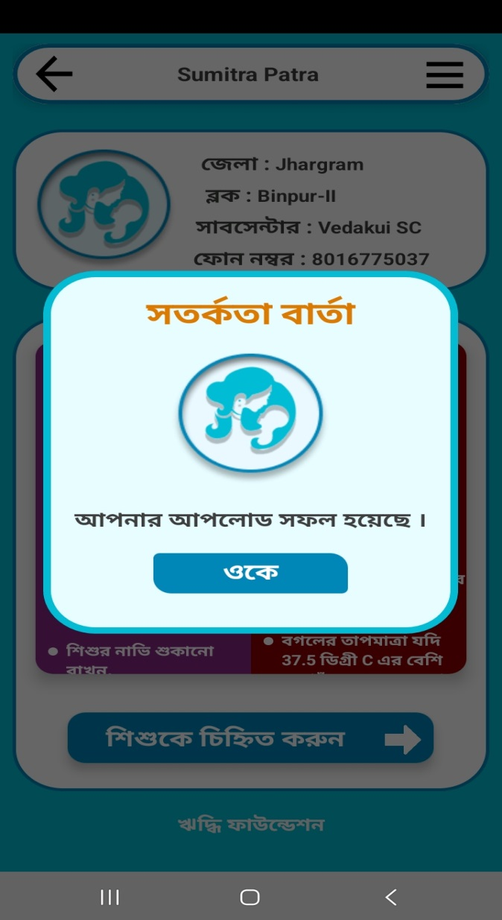
Note- Mobile internet connectivity is required
Tap on ‘ok’ Completed Upload stored files

